Slide 1
Introduction to Programming Language (Java)
Fariha Zahin
Lecturer
CSE, Southeast University

Slide 2
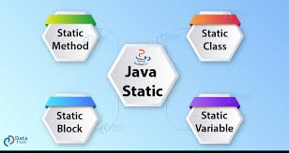
What is the static keyword?
A keyword used for memory management in Java.
It is used for creating class-level members, meaning they belong to the class rather than an instance.
Types of Static Members

Slide 3
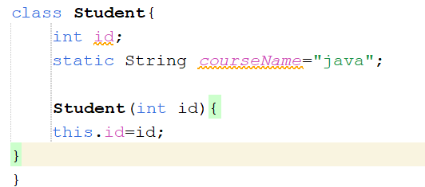
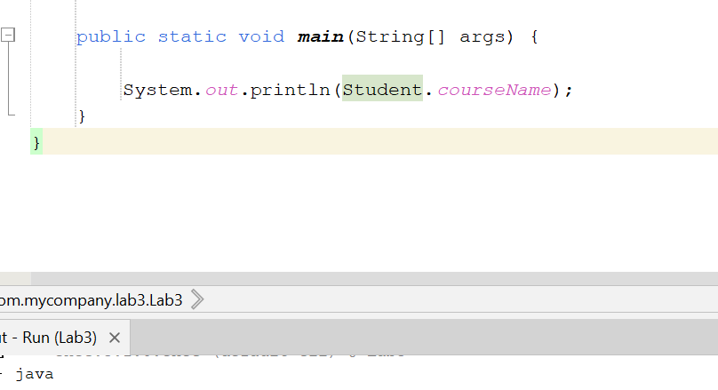
Static Variables
Definition:A variable declared with the static keyword is shared among all instances of the class.
Characteristics:
One copy of the static variable is shared across all objects of the class.
The static variable is initialized only once when the class is loaded into memory.
Variables declared with the static keyword can be called without creating an object of the class.

Slide 4
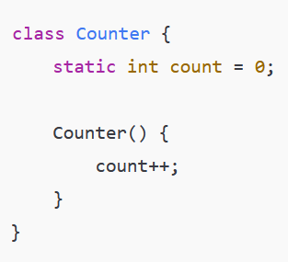
Brainstorming 1 : What will be the value of count if 3 objects of Counter class is created?

Slide 5
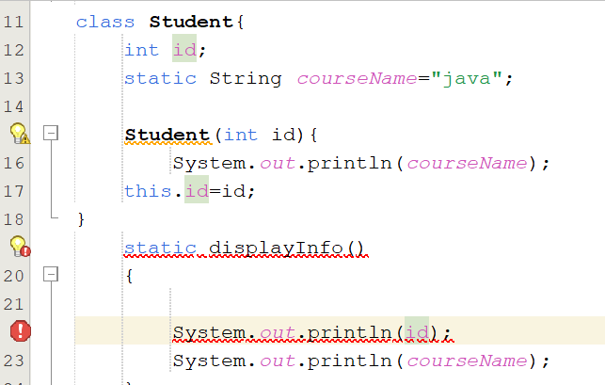
Static Methods
Definition: Methods declared with the static keyword can be called without creating an object of the class.
Characteristics:
A static method can only access other static members (variables and methods).
this and super keywords cannot be used here.

Slide 6
Brainstorming 2 : why main method is declared as static?

Slide 7
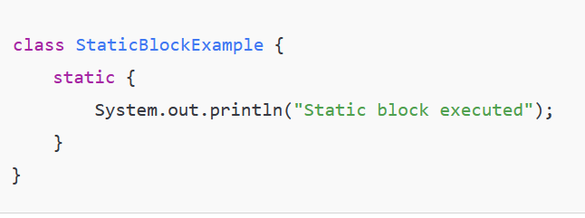
Static Blocks
Definition: A static block is used to initialize static variables or perform setup when the class is loaded.
Characteristics:
Executed once when the class is loaded into memory.
Can throw exceptions.
Executed before main method.

Slide 8
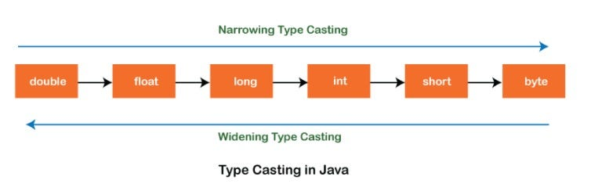
Type Casting
Type Casting is the process of converting one data type into another. It is of two types:
Implicit Type Casting (Widening)
Explicit Type Casting (Narrowing)
1. Implicit Type Casting (Widening)
Definition: Implicit type casting occurs when a smaller data type is automatically converted to a larger data type. This happens without the need for explicit casting, and it does not result in data loss.
.

Slide 9
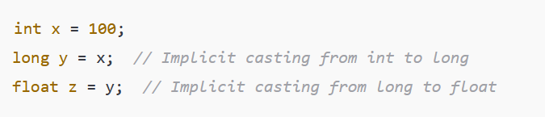
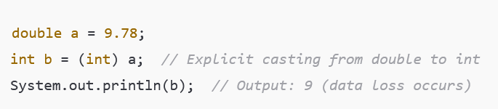
2. Explicit Type Casting (Narrowing)
Definition: Explicit type casting occurs when a larger data type is manually converted to a smaller data type. This requires the programmer to specify the type they want to cast the data to.
How it works:
When narrowing, there is a risk of data loss if the value doesn't fit in the target type. The programmer must be cautious when performing explicit casting.
Syntax for explicit casting: (targetType) value;

